Slide 1







Captcha for Visually Impaired
Organization: Dte of IT & Cyber Security, DRDO
Domain Bucket: Miscellaneous
Team Members
Ishwarya S (Team Leader)
Ashwin S
Abhinav S
Hari Prasath V
Abinaya P G
Naveen S
Department of Information Technology (III year IT-A)

Slide 2


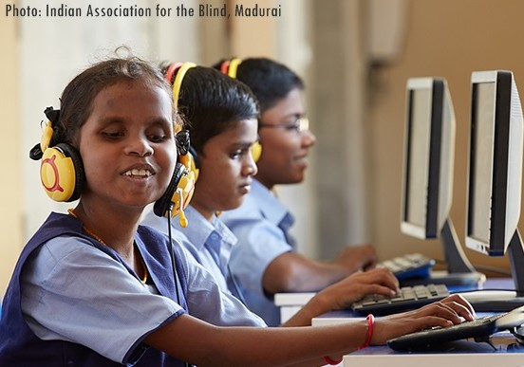
Our Objectives
To provide an alternative for the already existing solution for captcha process for visually impaired citizens through biometric authentication.
To use fingerprint scanner inbuilt in mobile for secure login of visually impaired users.
To initiate a voice command specifying the user to place their fingerprint when they are asked to do so.

Slide 3

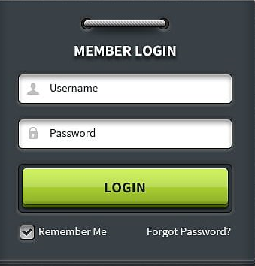
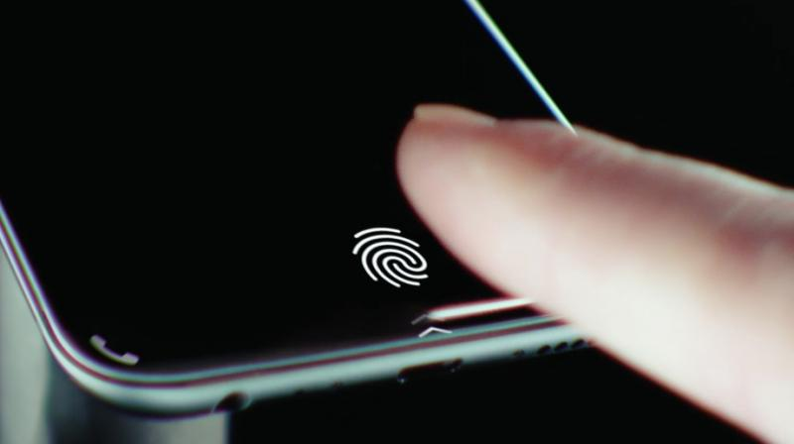
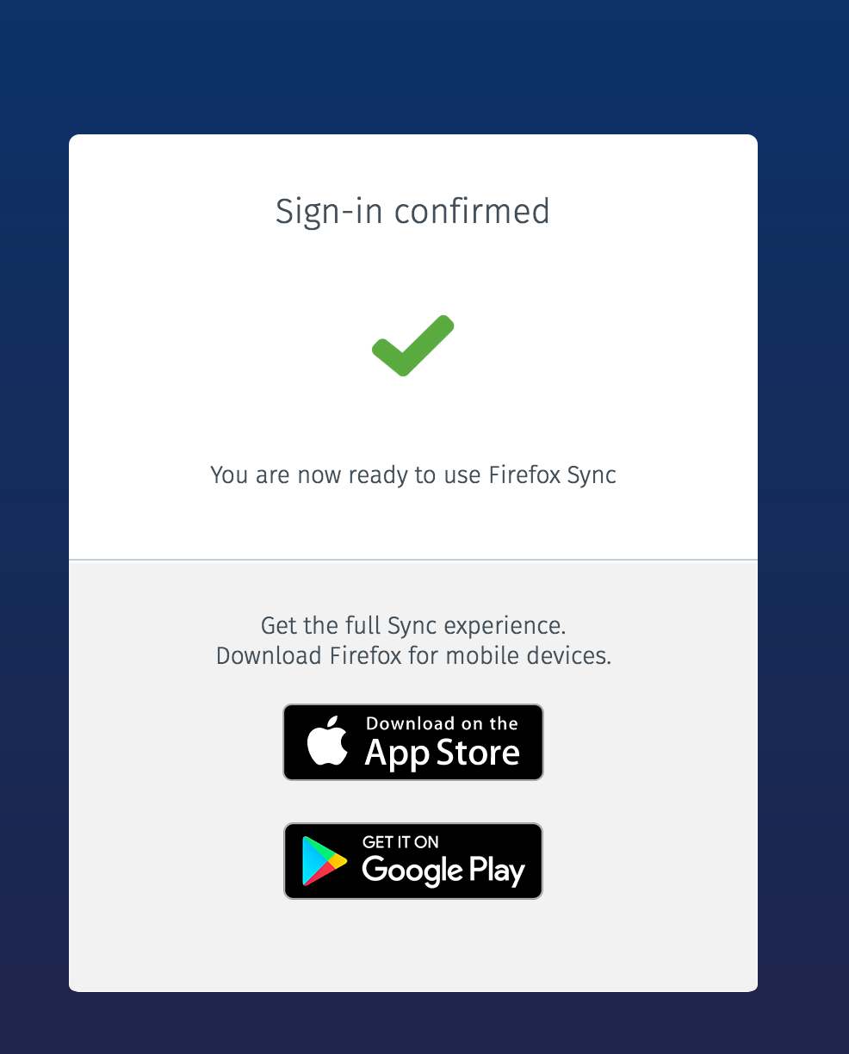
Ideation
1. The user searches for the website they need to log in. Here, they enter their registered login credentials.
2. Only after verifying their login credentials with the cloud database, an audio is played to the user, to place their fingerprint with the use of built-in fingerprint scanner.
3. The fingerprint of the user is validated, only if they match with the database, they are allowed to log in, otherwise they are again asked to place their fingerprint, instructed through an audio.

Slide 4








Workflow
4. An audio is played to request the user to place the fingerprint.
2. He/She enters the login credentials.
3. Their login data is verified with the database.
Registration.
7. (i) If the fingerprint matches with the existing data, they are allowed to log in.
(ii) Otherwise again they are allowed to place their fingerprint, such that they don’t exceed the number of trials stated (ex. 5).
Success
Exceeds trials
5. The fingerprint is placed by the user.
6. The fingerprint is validated.

Slide 5






Technology Stack

